Slide 1
The Strategic Plan for the FCI
A Plan for the Future, a Plan for Dogs Worldwide

Slide 2
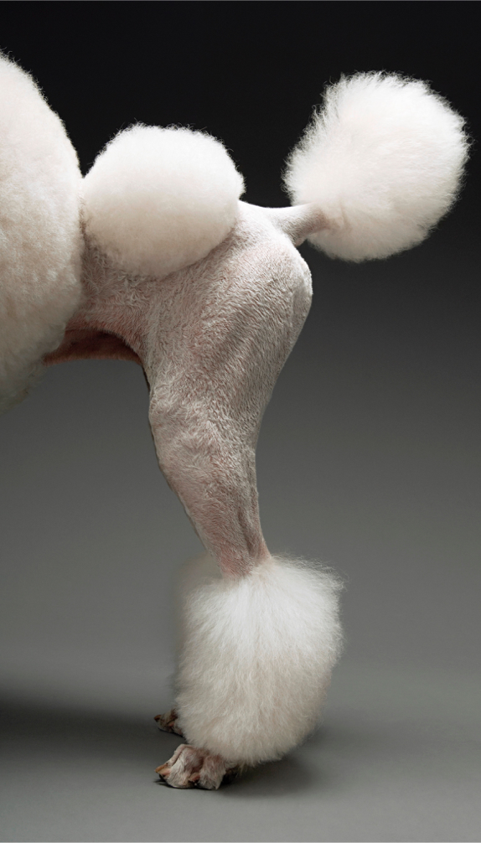
The FCI Agenda 2020 will be a strategic and detailed plan to guide the FCI for the next 5 years.
The FCI Agenda 2020 will take into consideration all of your ideas and suggestions and will focus in leading the discussion of the welfare of dogs around the world and secure the future of our organisation.
The FCI Agenda 2020 will lead and guide the discussions of the cynological world starting in 2016 and will address four overarching topics of Dog Welfare, Anti dog legislations, Cooperation and Youth.

Slide 3
The FCI Youth will be an important aspect of our future. I will continue to support youth initiatives in all of our countries to make sure that we keep the best human resources that will keep the FCI going forward and protecting pure-bred dogs.

Slide 4
We must continue to support our members in their efforts to protect dogs and their wellness. As the biggest canine organisation, we will keep supporting initiatives that ensure dog’s health and future, like the International Partnership for Dogs and any other non-profit initiatives. The FCI Scientific and Standards Commission will contribute to these efforts. We will entrust our commissions with specific investigations that will contribute, with important findings, the global discussion of dog welfare.

Slide 5
Anti dog legislations are the biggest threat to cynology, pure-bred dogs and dog owners around the world. These legislations are being introduced into our countries without the correct scientific data and without the experience of national canine organisations. As the World biggest dog advocate, we will insert ourselves in this discussion and lead it, to protect dog’s and their owners best interest. The FCI Agenda 2020 will develop the necessary measures to confront this matter, including an FCI lobbyist within the European Community, to insert us in this important discussion on National and International levels.

Slide 6
Last but not least, and for me the most important element of the FCI Agenda 2020, is cooperation. Cooperation between the FCI Members, cooperation between people who love dogs. To be able to reach our goal, it is important that we work on how we are going to cooperate with each other. We will design the necessary tool to hear everyone in the FCI.

Slide 7
Progress needs cooperation. The FCI future needs us. I believe we can seize the future together because we are not divided, as some may say. FCI is greater than the sum of our individual ambitions and we remain more than a collection of big and small countries.
Together, with your help, we will continue our journey forward and remind the cynological world that we are the biggest and the most important organisation for dogs worldwide. We are and for ever will be the Fédération Cynologique Internationale.

